Slide 1
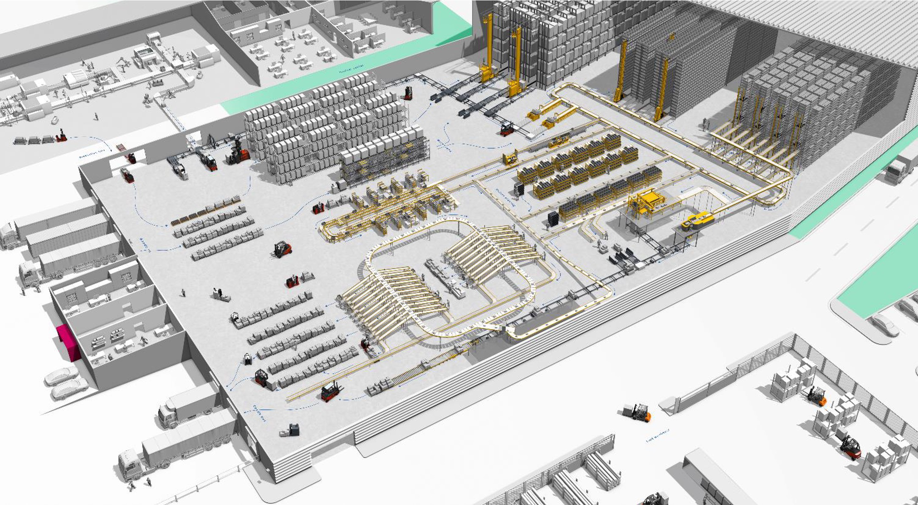
Artificial Intelligence, Automation, and the Case for Logistics
KION North America | Jonathan Dawley | October 2023

Slide 2
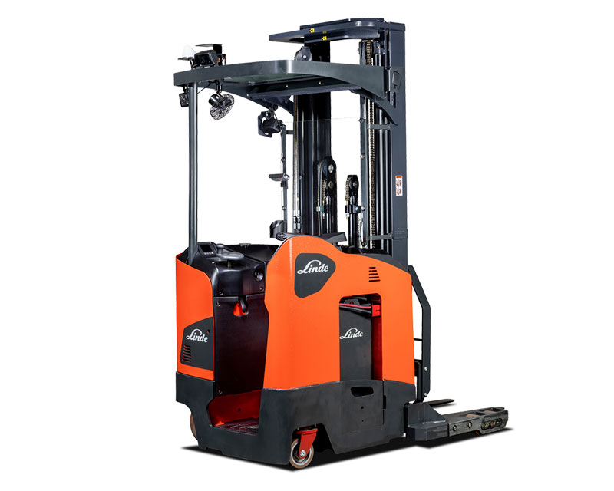
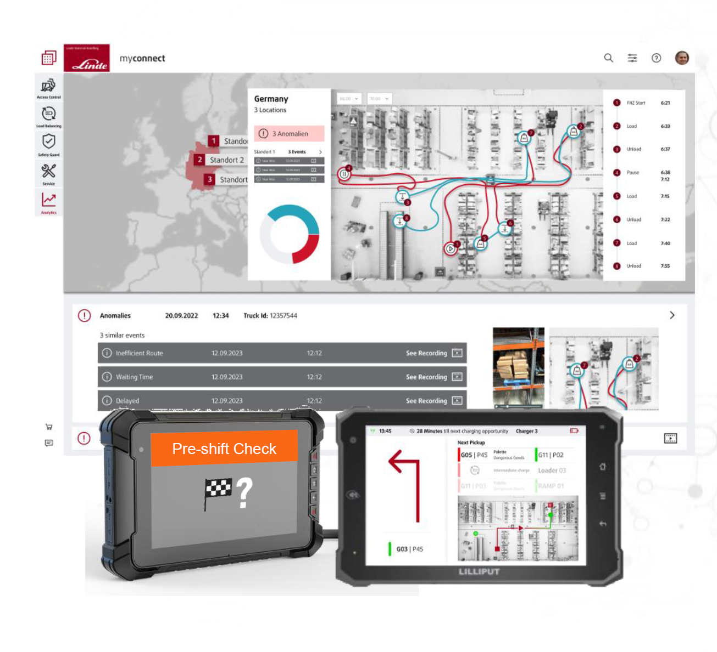
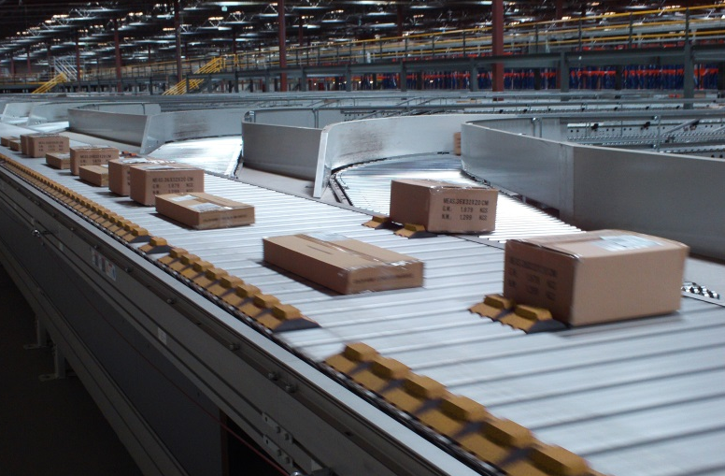
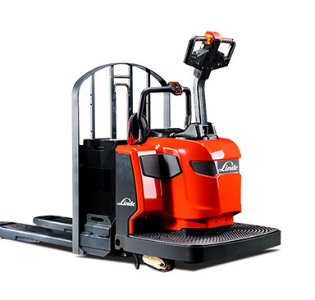
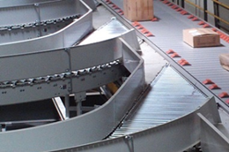
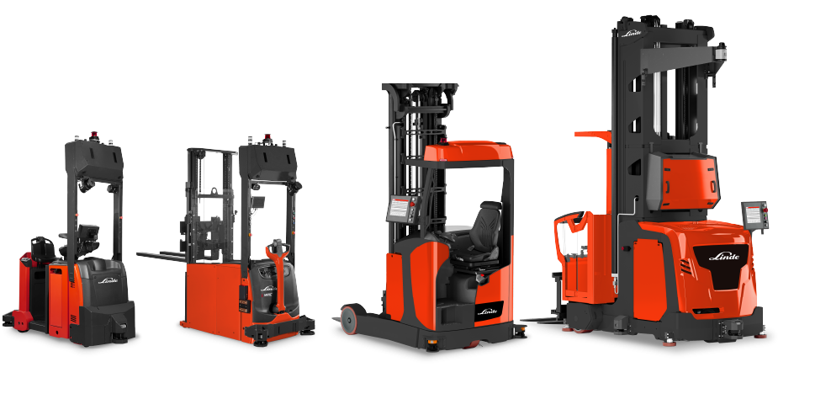
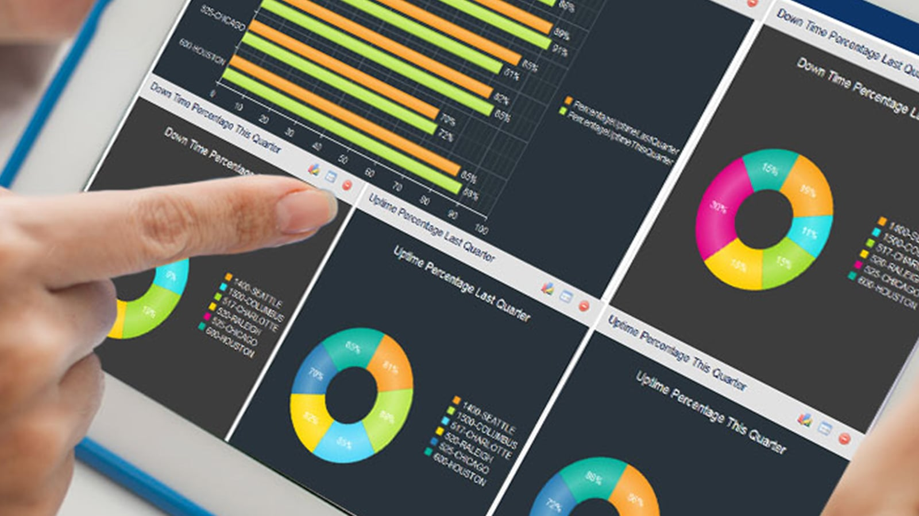
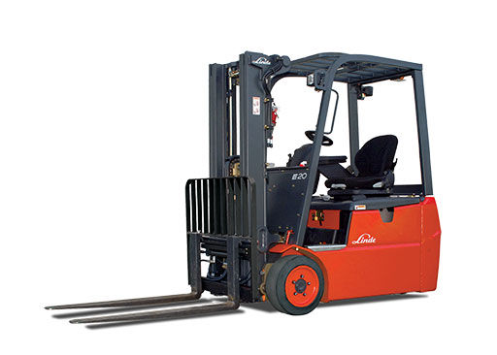
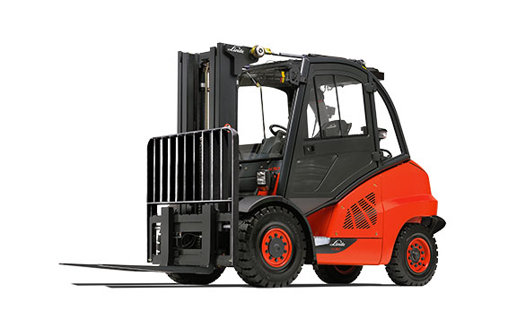
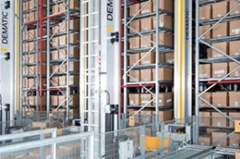
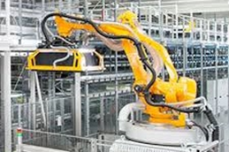
Introduction to KION
From intelligent vehicles to fully automated logistics processes
Premium Forklifts
Advanced Forklift Systems
Automated trucks
Automation systems
We increasingly provide automation, AI, and real-time data to improve how businesses manage operations to meet the needs of their customer.

Slide 3
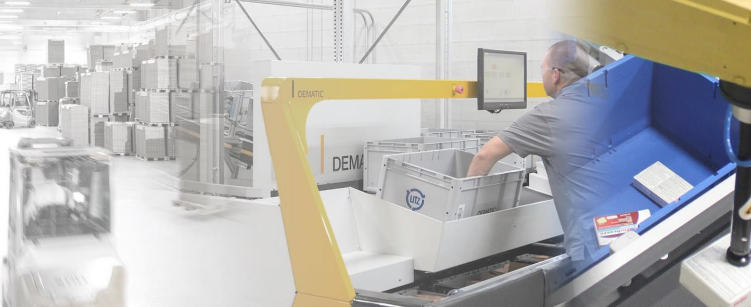
STATE of play in logistics
Path to ‘lights-out’ material handling solutions
Software & connected solutions
Lights-out
Micro-
fulfillment
Big data and analytics
Fleet
management
New energy sources
Autonomous vehicles
Assistance
systems
Advanced robotics
Sustainable products
Industrial trucks & Automation systems
Yesterday
Today
Tomorrow
Material handling – technology trends (illustrative)

Slide 4
Current Trends & impacts
Post-COVID world requires speed, flexibility and accuracy
Manage
Cost & Growth
Labor & Safety
Efficiency
10%
60%
80%
Speed
Shoppers want same-day delivery
Logistics Expenditure
Rate of logistics cost to GDP
Skill Shortage
Turnover in warehousing in US
26%
E-Commerce Growth
Y-o-Y growth in global sales
85m
Workforce Shortage
Exp. global shortage by 2030
10%
Automation
Warehouses fully automated
1.3x
7k+
2.5x
# of Warehouses
Global increase till 2027
Lift Truck Injuries
Annual injuries in US, 2022
Adoption of AI
Increase since 2017
Accelerated demand for intelligent, connected and automated supply chain.

Slide 5
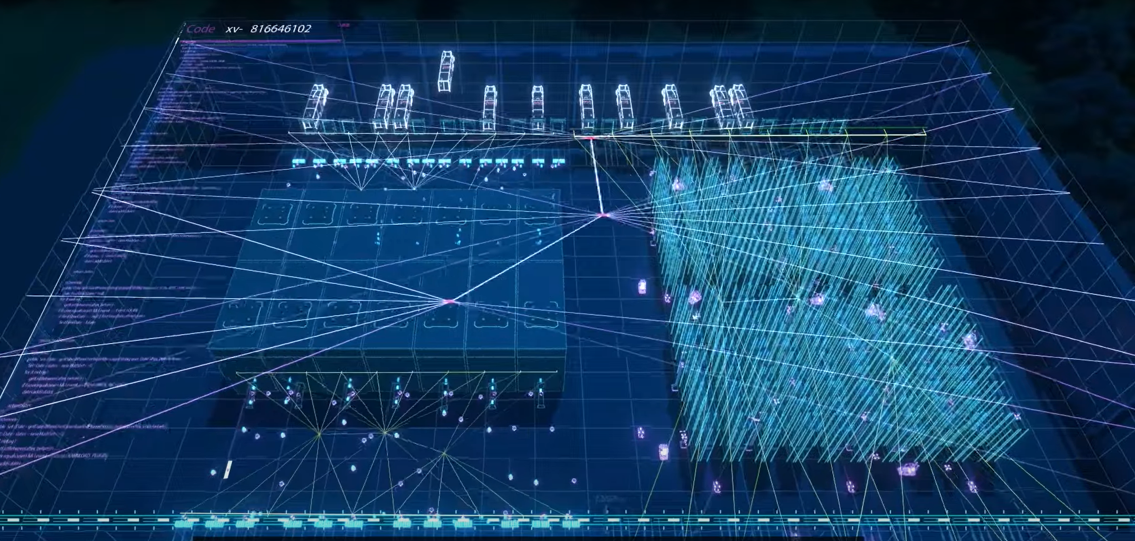

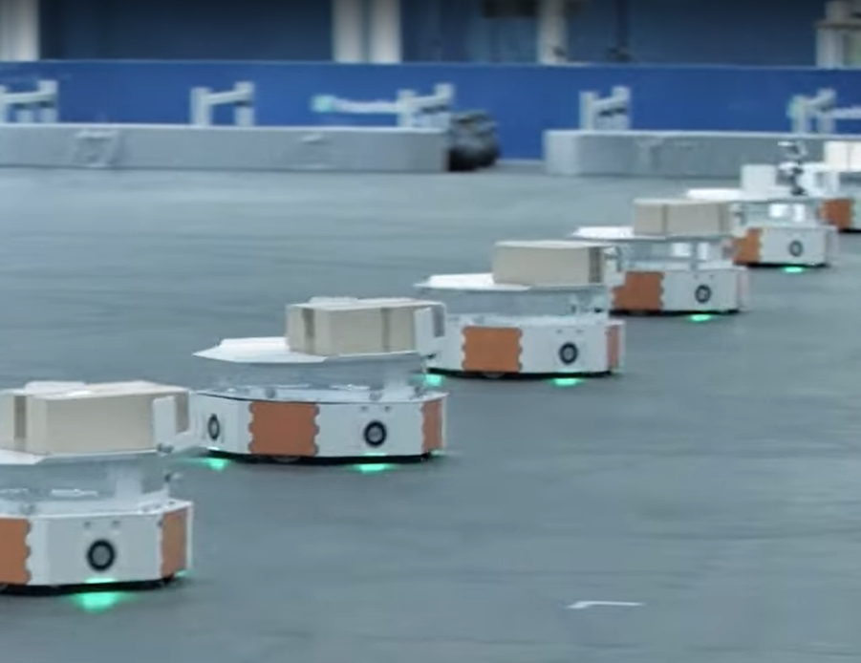
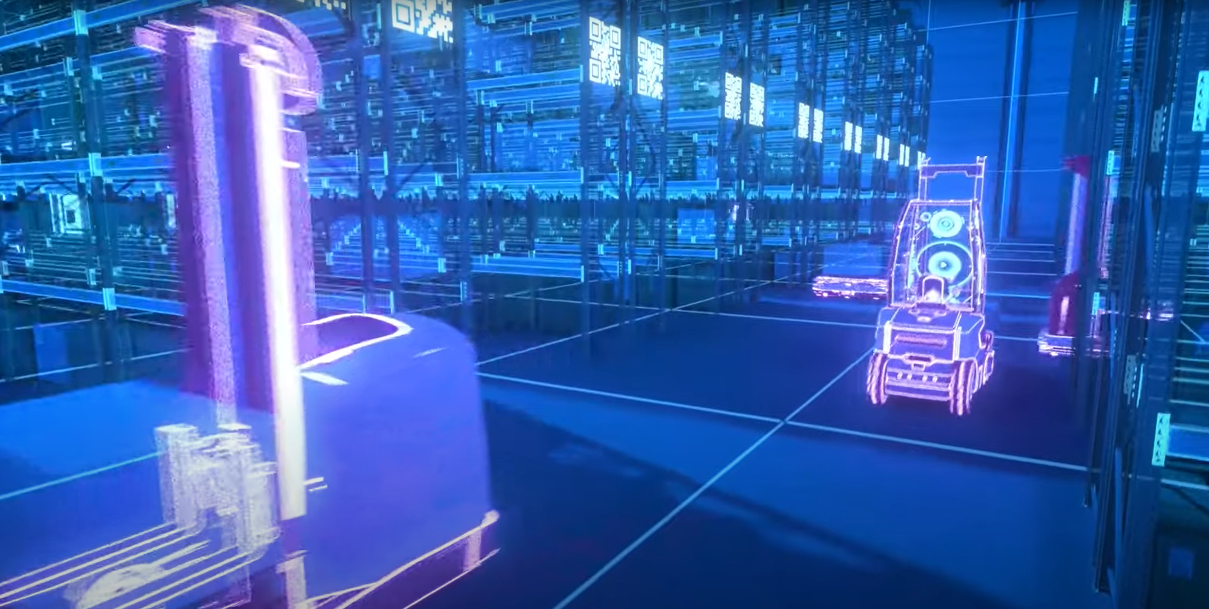
A look into the future…
Scan for Video
Warehouses are…
…digital, automated, and sustainable.
…adaptable, connected, & with swarms of vehicles.
…networked and controlled by artificial intelligence.

Slide 6
transformation journey
Phase 1
Basic Warehouse / First Automation
Phase 2
State of the Art Warehouse / Digital
Phase 3
NextGen Warehouse Autonomy
Phase 4
Autonomous Supply Chain / Ecosystem
From automated forklift to full automation
From traditional AI/ML to generative AI

Slide 7
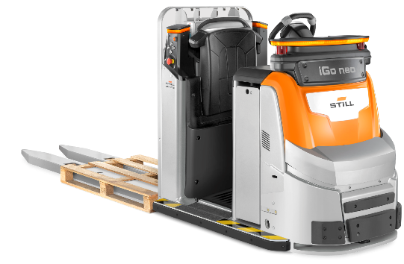
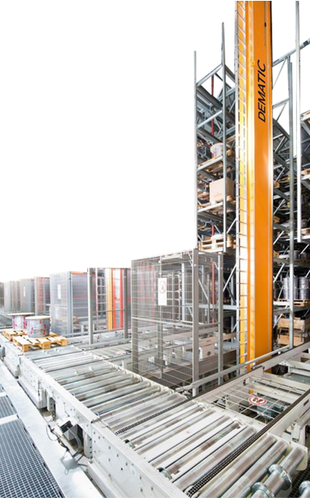
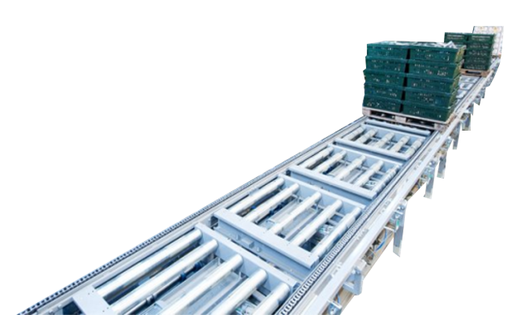
automation in logistics
Intelligent and autonomous Industrial Forklifts
Driver Assistance Systems
iGo neo: the autonomous partner for order picking.
Automated KION Forklifts
Fully automated transports without a driver
Horizontal pallet transport up till high lift storage
Stationary Automation
Systems and software solutions for the most diverse areas of application and a fully automated logistics process.

Slide 8
AI in logistics
AR / VR
Inventory Optimization
Predictive Maintenance
V-SLAM
Energy management
Route Optimization
NLP
Anomaly Detection
Enabling new applications &
decision-making with AI.
Increase efficiencies, safety, customer satisfaction, uptime and your bottom line.
Automated
Teach-In
Digital Twin / Edge Computing
Customer Service Chatbot
AI has limitless potential - Experts project
that by 2035 AI can enhance logistics
productivity by a staggering 40%.
Dynamic Pricing
Driver Assistance System
Document Processing
M/L Based Perception for Lorry Un-/Loading

Slide 9
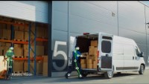
AI & Automation in Action

Slide 10
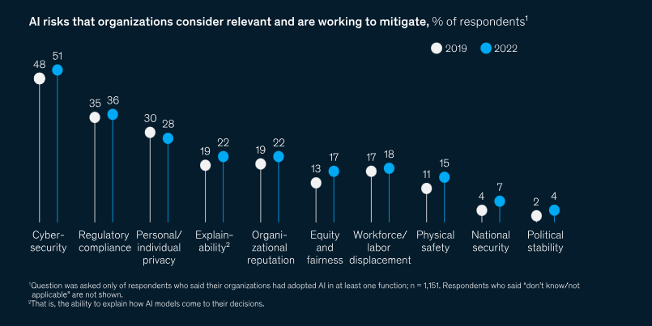
A word of caution
Source: McKinsey

Slide 11
It’s time to act
Inevitable integration of AI and automation in logistics
Lost Sales
By applying latest technologies, companies can unlock huge potential in all supply chain categories.
CUSTOMER
Increasing Transport & Warehousing Cost
AGILITY
Increasing Supply Chain Admin Cost
CAPITAL
COST
Inventories / Assets

Slide 12
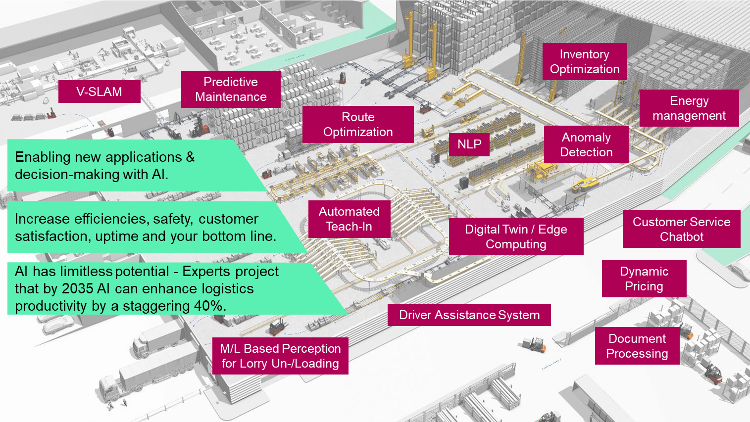
Let’s discuss

Slide 14
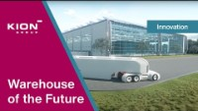
A look into the future…

Slide 15


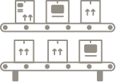
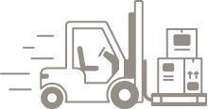
From trucks to automation systems
Intelligent trucks
Cloud based fleet data management
Automated trucks
Automation systems
    Trucks equipped with electronic control unit
    Increased efficiency also from driver assistance systems
    Fleet data services connect trucks with management tool
    Financial and security benefits
    Broad range of automated series trucks
    Enable automation of the entire material flow
    Customized integrated soft- and hardware intralogistics solutions
    Solutions for robotic
    piece picking

Slide 16
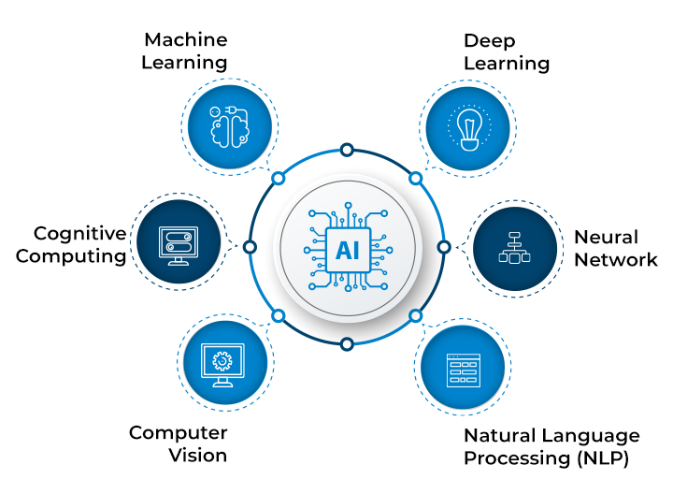
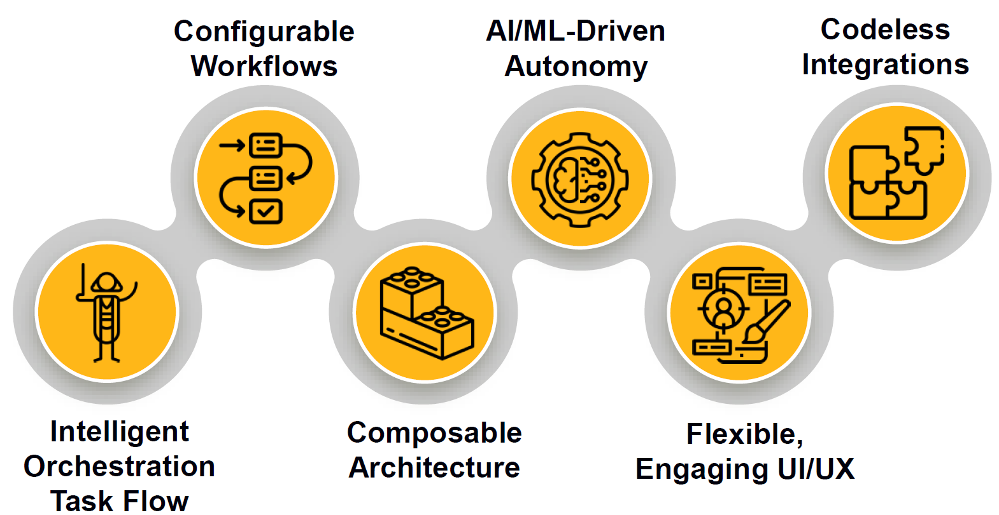
Adoption of artificial intelligence
Key Components of AI
AI in products or processes
AI in Supply Chain is expected to grow to $46B at 45% CAGR by 2029
98% of companies will use generative AI within the next 18 months
Traditional AI
Generative AI

Slide 17
Adoption of artificial intelligence
Key Components of AI
AI in products or processes
RPA
Computer
Vision
Text
Virtual Agents
Deep Learning
Knowledge Graphs
Recommender Systems
Top answers from McKinsey Survey (2022): Respondents who said their organizations have adopted AI in at least one function.
Digital Twins
Speech
Physical Robots
Traditional AI
Generative AI

Slide 18
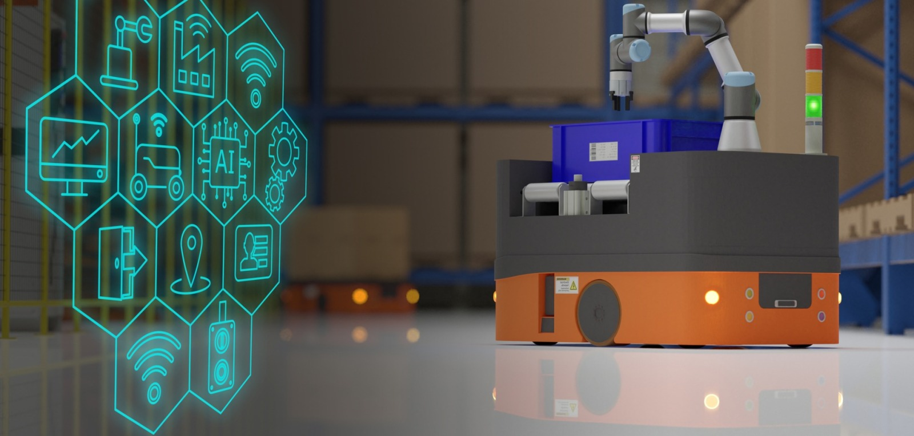
Digital Twin
AI in the Internet of things
AI
Action
New action taken by orchestrating assets/tasks.
Insight
What AI model finds & learns
Virtual, physics-based environments are just starting to emerge in warehouses
Leverage combination of edge and cloud plus advanced software for compute, model development & machine learning
Advanced data analytics still needs deep domain human perspective
Data / Cloud
How data is gathered
Connectivity
How devices are connected
IoT
Things / Edge
Connected assets with sensors

